Slide 1
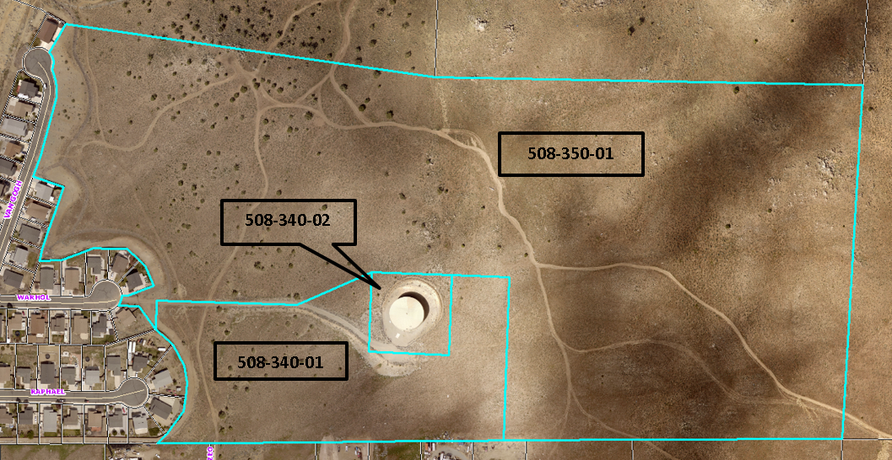
WSUP20-0008 Five Ridges
Washoe County Board of Adjustment
June 4, 2020

Slide 2
Request
The application is requesting a special use permit (SUP) to approve major grading of an area of approximately 2.5 acres with 10,582± cubic yards of cut and 10,267± cubic yards of fill to construct a paved gated emergency access road for the Five Ridges Project and to allow for an utility service use for a 16-inch water main

Slide 3
Special Use Permit Requirements
The proposed use of utility service is permitted in Public and Semi-Public Facilities (PSP) and Open Space (OS) regulatory zones with a special use permit per WCC Table 110.302.05.2.
The proposed grading is permitted with a special use permit per WCC 110.438.35.
Therefore, the applicant is seeking approval of this SUP from the Board of Adjustment.

Slide 4
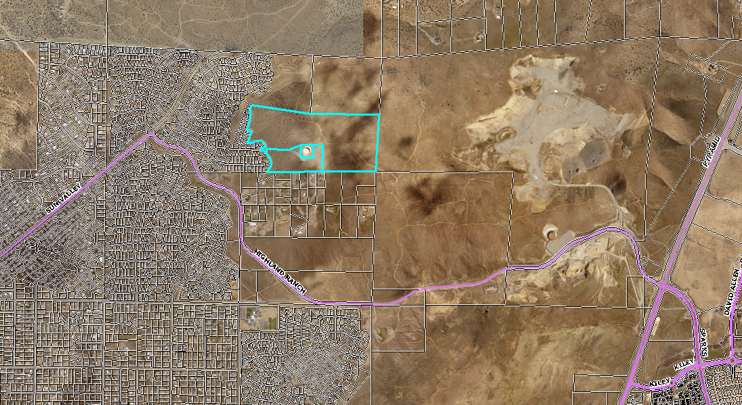
Vicinity Map

Slide 5
Request/Background
The request is to upgrade the existing dirt road to the water tank construct a road east of the water tank to the proposed Five Ridges development in the City of Sparks.
The 20 foot-wide paved road will be maintained by the Five Ridges Homeowner’s Associate (HOA) as required by the development agreement with the City of Sparks.
The water line will be underground and constructed to run from the water tank to the Five Ridges development, along the proposed roadway alignment.
Washoe County will not have any maintenance obligations for the roadway or water line.

Slide 6
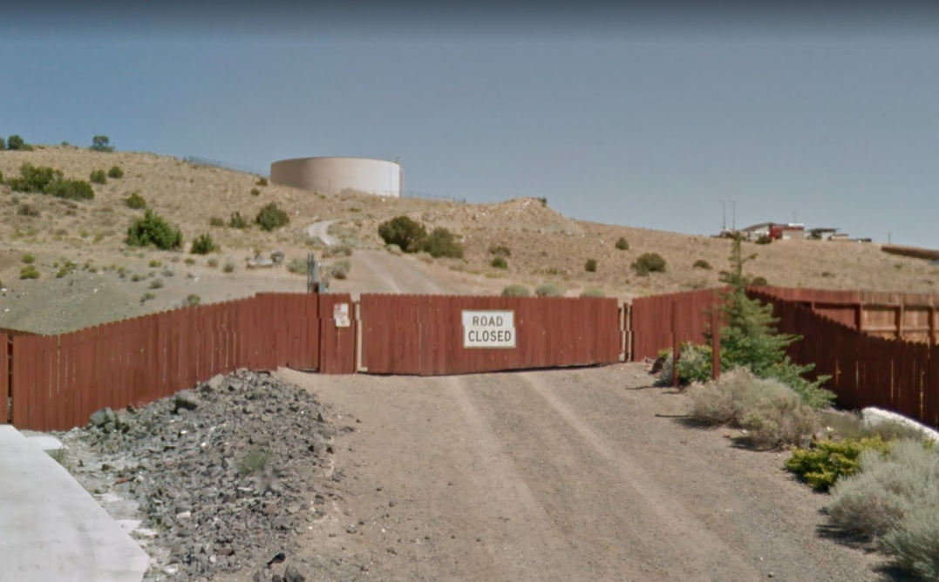
Existing water tank road

Slide 7
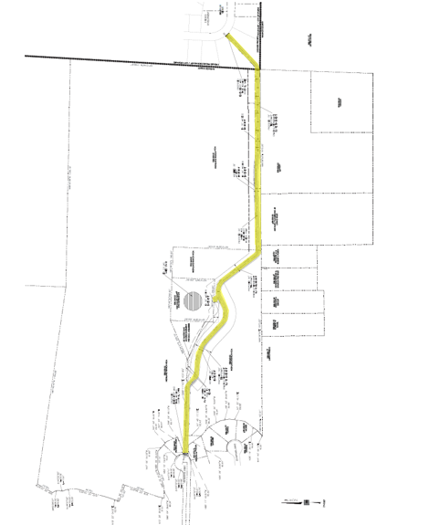
Existing water tank
Five Ridges Development

Slide 8
Grading Requirements
For this application a special use permit is required per WCC 110.438 for the following requirements:
1. More than 5,000 cubic yards are proposed to be graded – the application is requesting 10,600 cubic yards of cut and 10,300 cubic yards of fill;
2. More than 10% of parcel 508-340-01 is proposed to be graded - the application is requesting 1.35 acres will be disturbed of the 10.06 acres; and
3. More than 1,000 cubic yards will be graded on slopes in the excess of 15% - the application is requesting to grade slopes of 15% or more on the two larger parcels.

Slide 9
Analysis
There are areas where the slope is 2:1, which is allowed by code when the parcel is over 5 acres and the grading is more than 100 feet from the property line
However there are 2:1 slopes that are less than 100 feet from the property line and the applicant is requesting to vary the code requirement
Rip-rap is proposed on site, however, it will be covered with dirt and vegetation as required by code

Slide 10
Public Notice & CAB
Public notice was sent to parcel within 500 feet from the site and 120 notice were sent
The Sun Valley CAB did not meet during the month of April and May
Paper worksheets were sent to each CAB member and no comments were received

Slide 11
Reviewing Agencies
Various agencies reviewed the application, their comments are included in the staff report
Agencies with conditions, are included in the Conditions of Approval

Slide 12
Special Us Permit Findings
1. Consistency;
2. Improvements;
3. Site Suitability; and
4. Issuance Not Detrimental
Staff is able to make all the required findings, as detailed in the staff report

Slide 13
Possible Motion
I move that, after giving reasoned consideration to the information contained in the staff report and information received during the public hearing, the Washoe County Board of Adjustment/Planning Commission approve with conditions Special Use Permit Case Number WSUP20-0008 for Highland Ranch HOA and Sun Valley Water and Sanitation, having made all five findings in accordance with Washoe County Code Section 110.810.30

